Slide 1
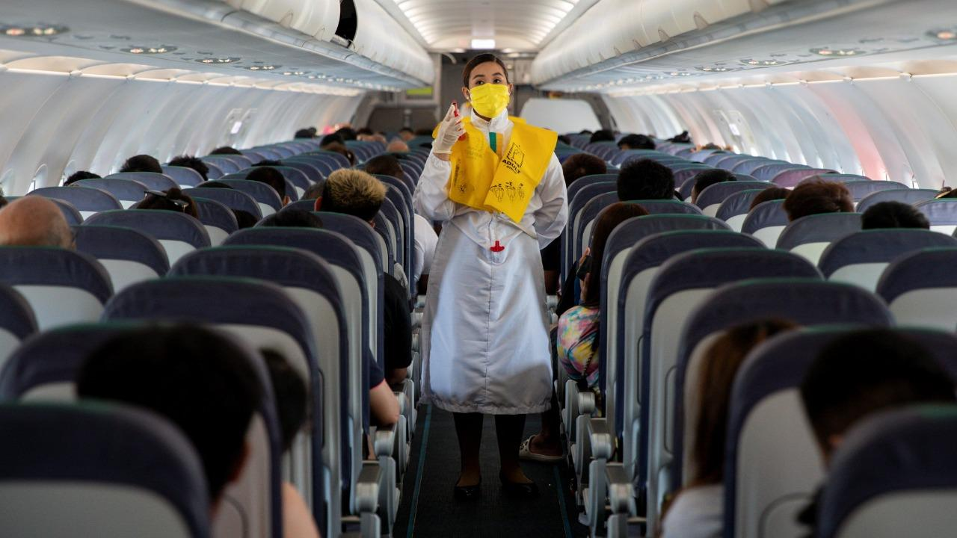
US Airline Delay Causes & How COVID-19 Impacted Them

Slide 2
Talk Data To Me!
Before we dive into delays, cancellations, and their causes (oh, my!) …let’s talk data:
Collect the Data:
Define the question.
Determine the correct Dataset.
Formulate hypotheses.
Access the Data:
Convert to DataFrame.
Interpret column descriptions.
Determine column formats for analysis.
Clean the Data:
Determine the size of the data.
Eliminate the null data.
Eliminate the columns.
Eliminate the duplicates.
Notes:
MV: I’ll speak to the general process, touch on points by giving a brief explanation, and then we move onto the Dataset, questions section, and then our analysis. // Can speak to our original chosen Dataset to share part of our process.

Slide 3
“The goal is to turn data into information and information into insight.” - Carly Fiorina, former CEO of Hewlett Packard

Slide 4
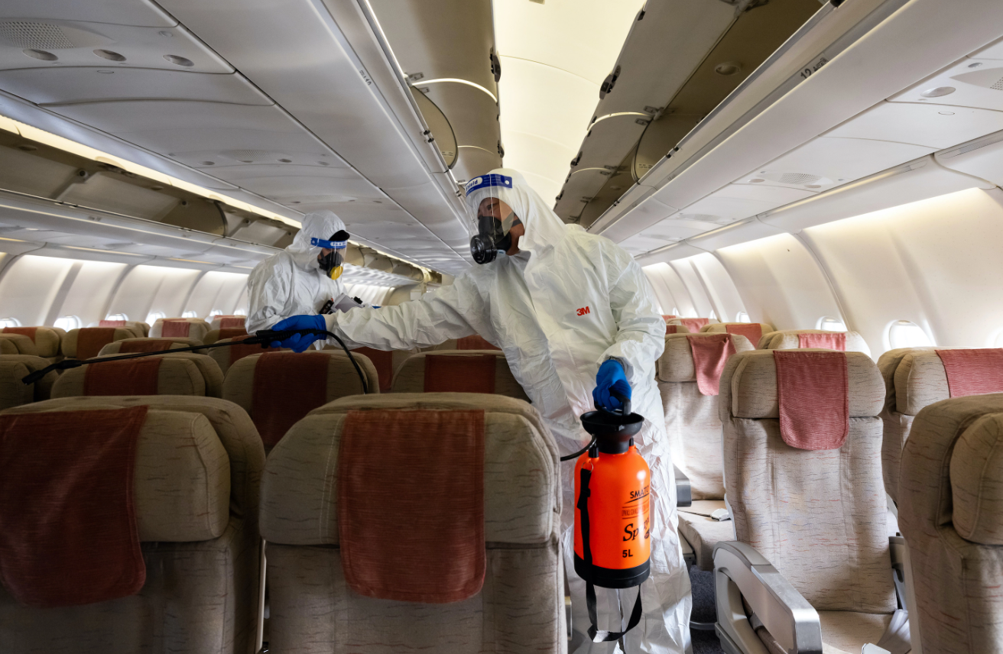
BDE:
Big Data Explained
Now that we’re back in Kansas, let’s dive into the dataset.

Slide 5
USA Airline Delay Cause
& The Questions We Had
How much of an impact did COVID-19 have on the airline industry?
Which airline has the highest percent of flights get delayed?
Which airline has the highest percent of flights get cancelled?
Notes:
Christian will speak here.

Slide 6

Who’s Your Data?
Let’s Analyze.
Notes:
Can use as segue for Anthony to answer 1st Question.

Slide 7
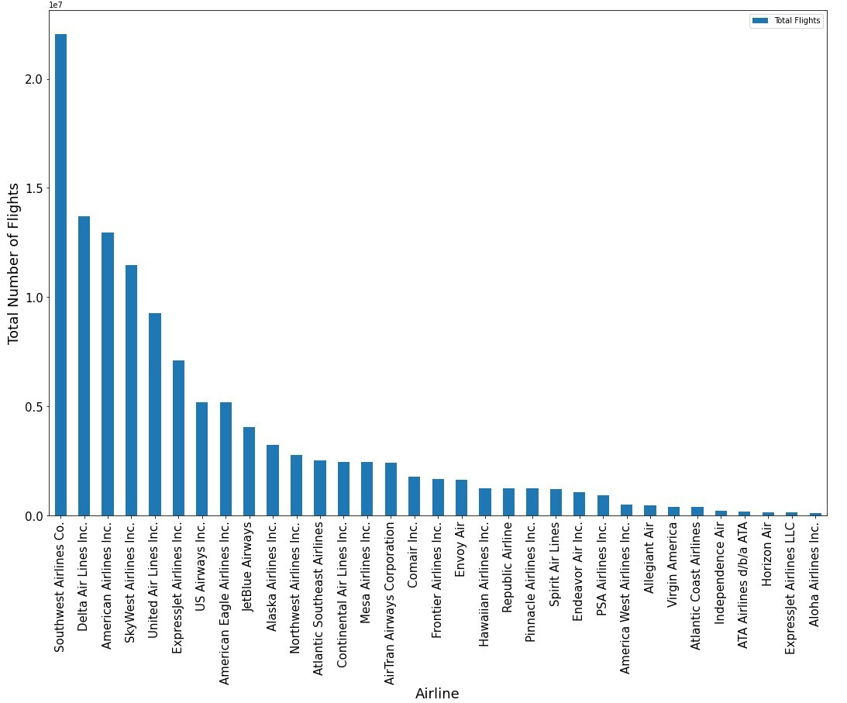

Slide 8
Total Number of Flights (2003-2022)
1
Most Flights from 2003-2022
Southwest - 22 Million
Delta - 13.7 Million
American - 13 Million
Skywest - 11.5 Million
United - 9.2 Million

Slide 9
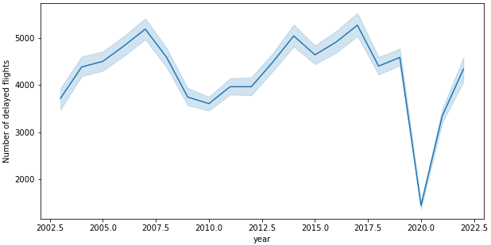

Slide 10
Number of Delayed Flights
1
2
Line Plot: Created the line plot using the seaborn library and eased the process to turn the plot into a graph.
Formula: sns.lineplot(data=df1, x="year", y="arr_cancelled")
plt.ylabel('Number of cancelled arrivals')
Notes:
MV: formatted version; leaving the old one in case edits are unwanted or leave out detail.

Slide 11
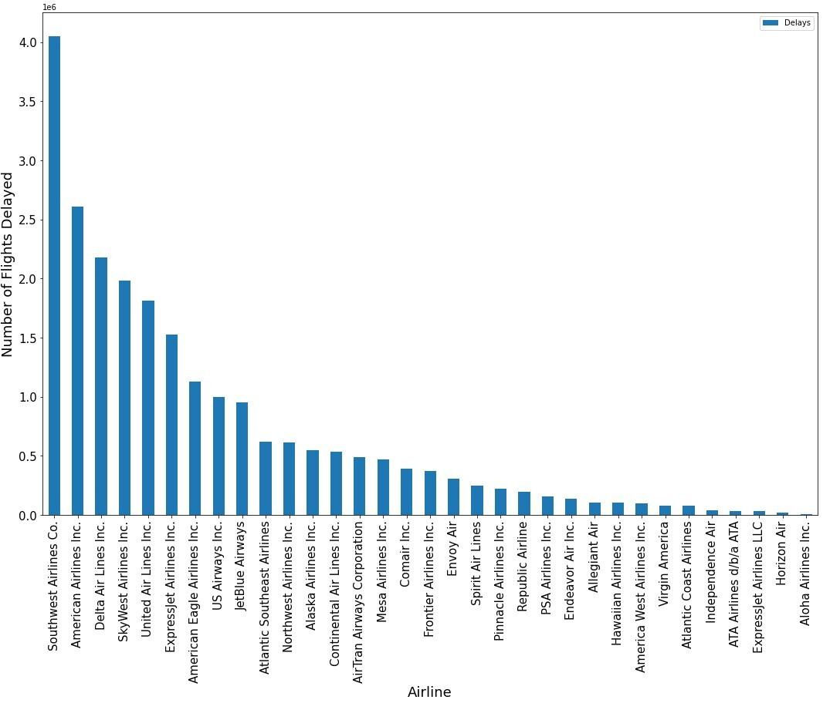

Slide 12
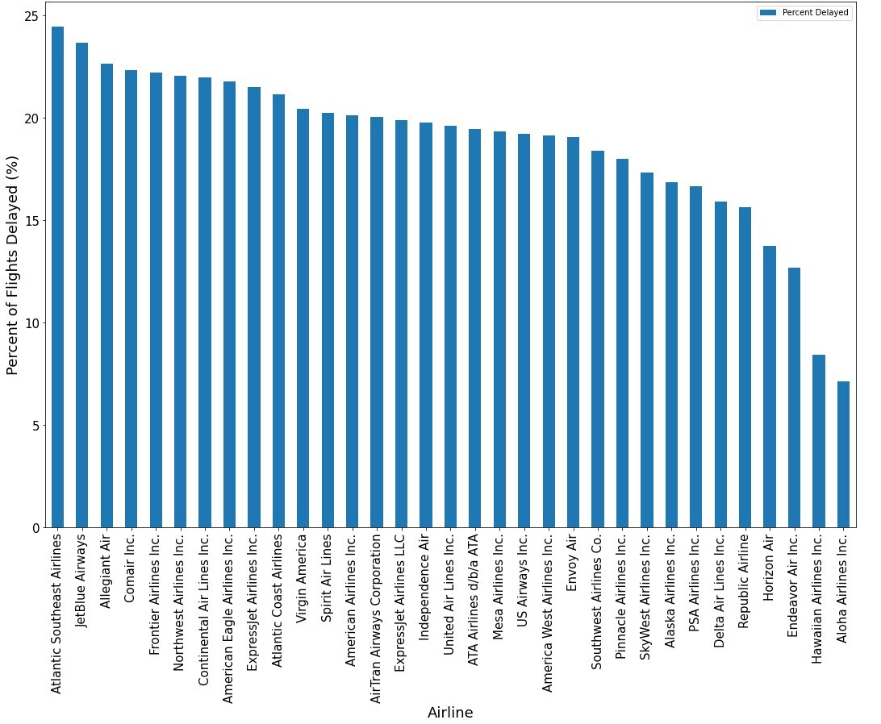

Slide 13
Percent of Delayed Flights (2003-2022)
1
2
Highest Percent of Flights Delayed:
Atlantic 24.5%
JetBlue 23.7%
Allegiant 22.6%
Comair 22.3%
Frontier 22.2%
Lowest Percent of Flights Delayed:
Aloha 7.1%
Hawaiian 8.4%
Endeavor 12.7%
Horizon 13.7%
Republic 15.6%

Slide 14
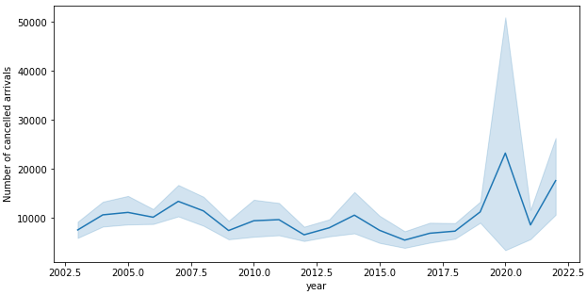

Slide 15
Number of Cancelled Arrivals
1
2
Line Plot: Same process as the Delayed Arrivals line graph for the Cancelled Arrivals, using the seaborn library.
Formula: plt.figure(figsize=(10,5))
sns.lineplot(data=airline_clean_df, x="year", y="arr_delay")
plt.ylabel('Number of delayed flights')
Notes:
MV: formatted version; leaving the old one in case edits are unwanted or leave out detail.

Slide 16
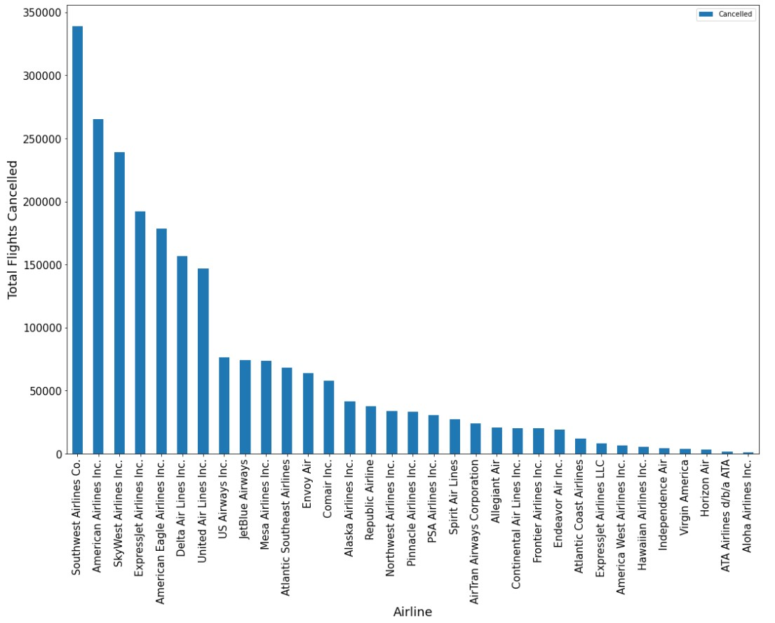

Slide 17
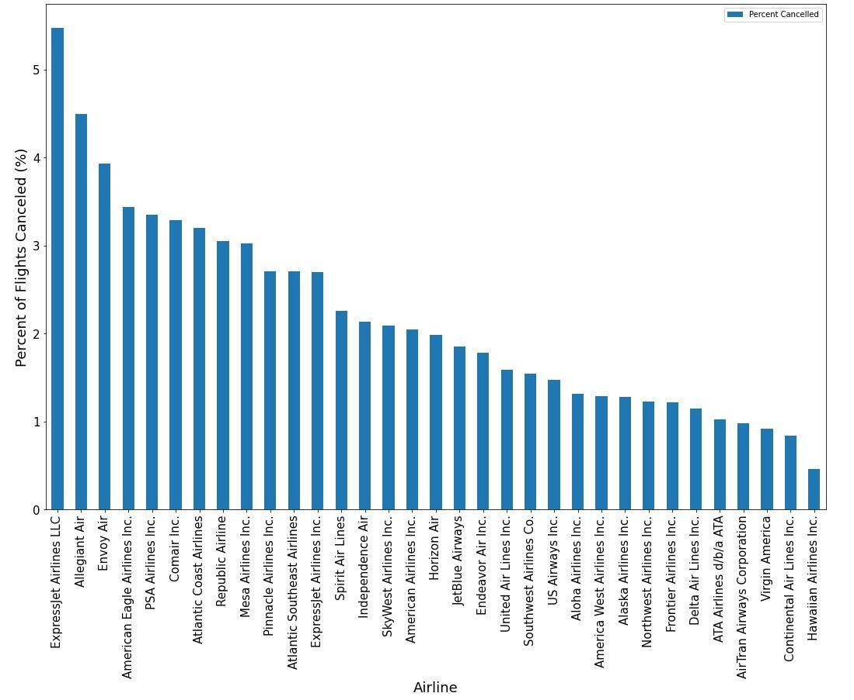

Slide 18
Percent of Cancelled Flights (2003-2022)
1
2
Highest Percent of Flights Cancelled:
Expressjet 5.5%
Allegiant 4.5%
Envoy 3.9%
American Eagle 3.4%
PSA 3.3%
Lowest Percent of Flights Cancelled:
Hawaiian 0.5%
Continental 0.8%
Virgin America 0.9%
Airtran 1%
ATA 1%
Airline to Avoid: Allegiant Airlines.
Allegiant Airline is in the top 5 most cancelled and most delayed flights data.

Slide 19
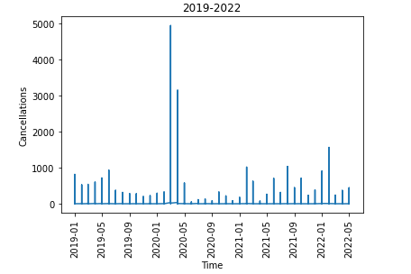
Notes:
MV: Points of Interest to consider, Christian: 03-2020 to 05-2020 were lockdown dates for the US & the EU, and 02-2021, 08-2021, and 02-2022 were due to [unknown], Delta mutation surge, and Omicron mutation surge. Wanted to cover parts of this in my own line graph if possible, still working on it; but for your graph, thought you might be interested.

Slide 20
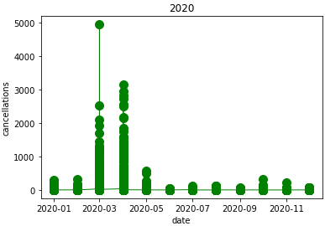

Slide 21
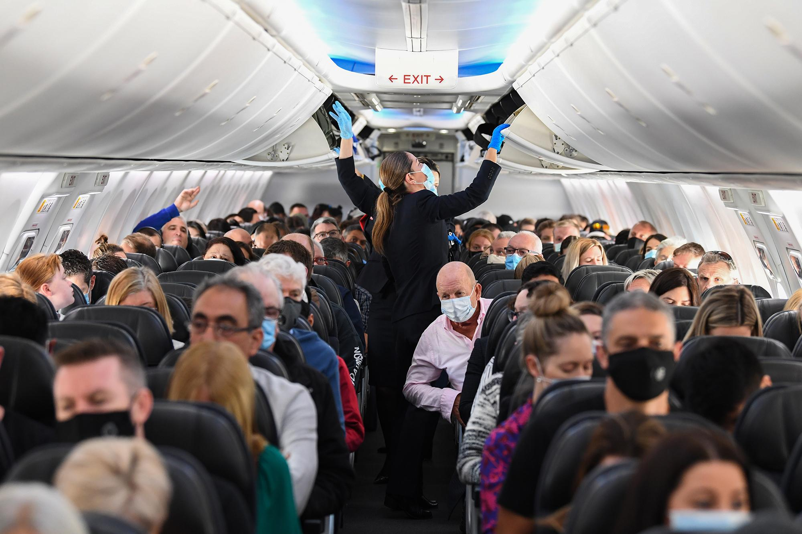
Notes:
MV: What does this lead to/mean? Explain to audience briefly as to what this extracted data and analysis essentially provides.

Slide 22
To Reiterate…
After looking at available metrics of flights, locations, carriers, delays, cancellations, and all over time we see a significant impact of COVID-19.
Reached an all-time high in March 2020.
Atlantic has the highest delay rate.
Expressjet has the highest cancellation rate.

Slide 23
Questions, Comments, Thoughts?

Slide 24
Thank you!

Slide 25
Team Members
Charlie Freeman
Team Lead
Christian Nava
Co-Team Lead
Brinda Gajjar
Team Morale
Anthony Rocco-Frank
Data Wizard
Madeline Vicuna
PPT & Jokes

